Slide 1
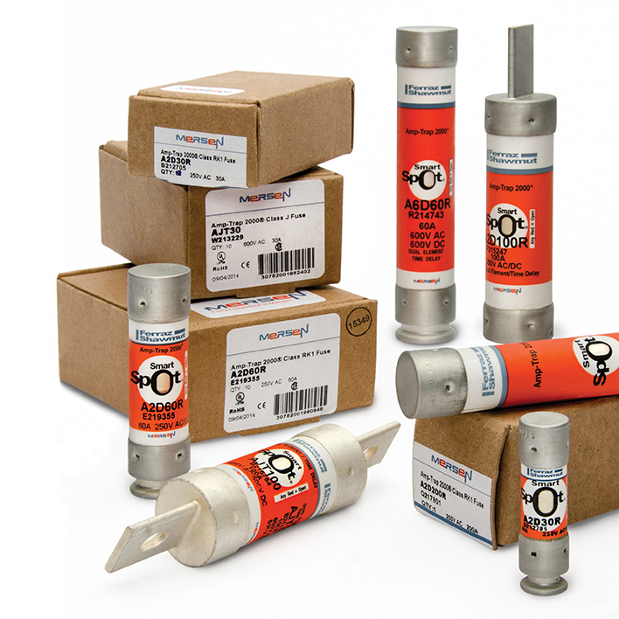
Amp-Trap®
2000
Fuse Family

Slide 2
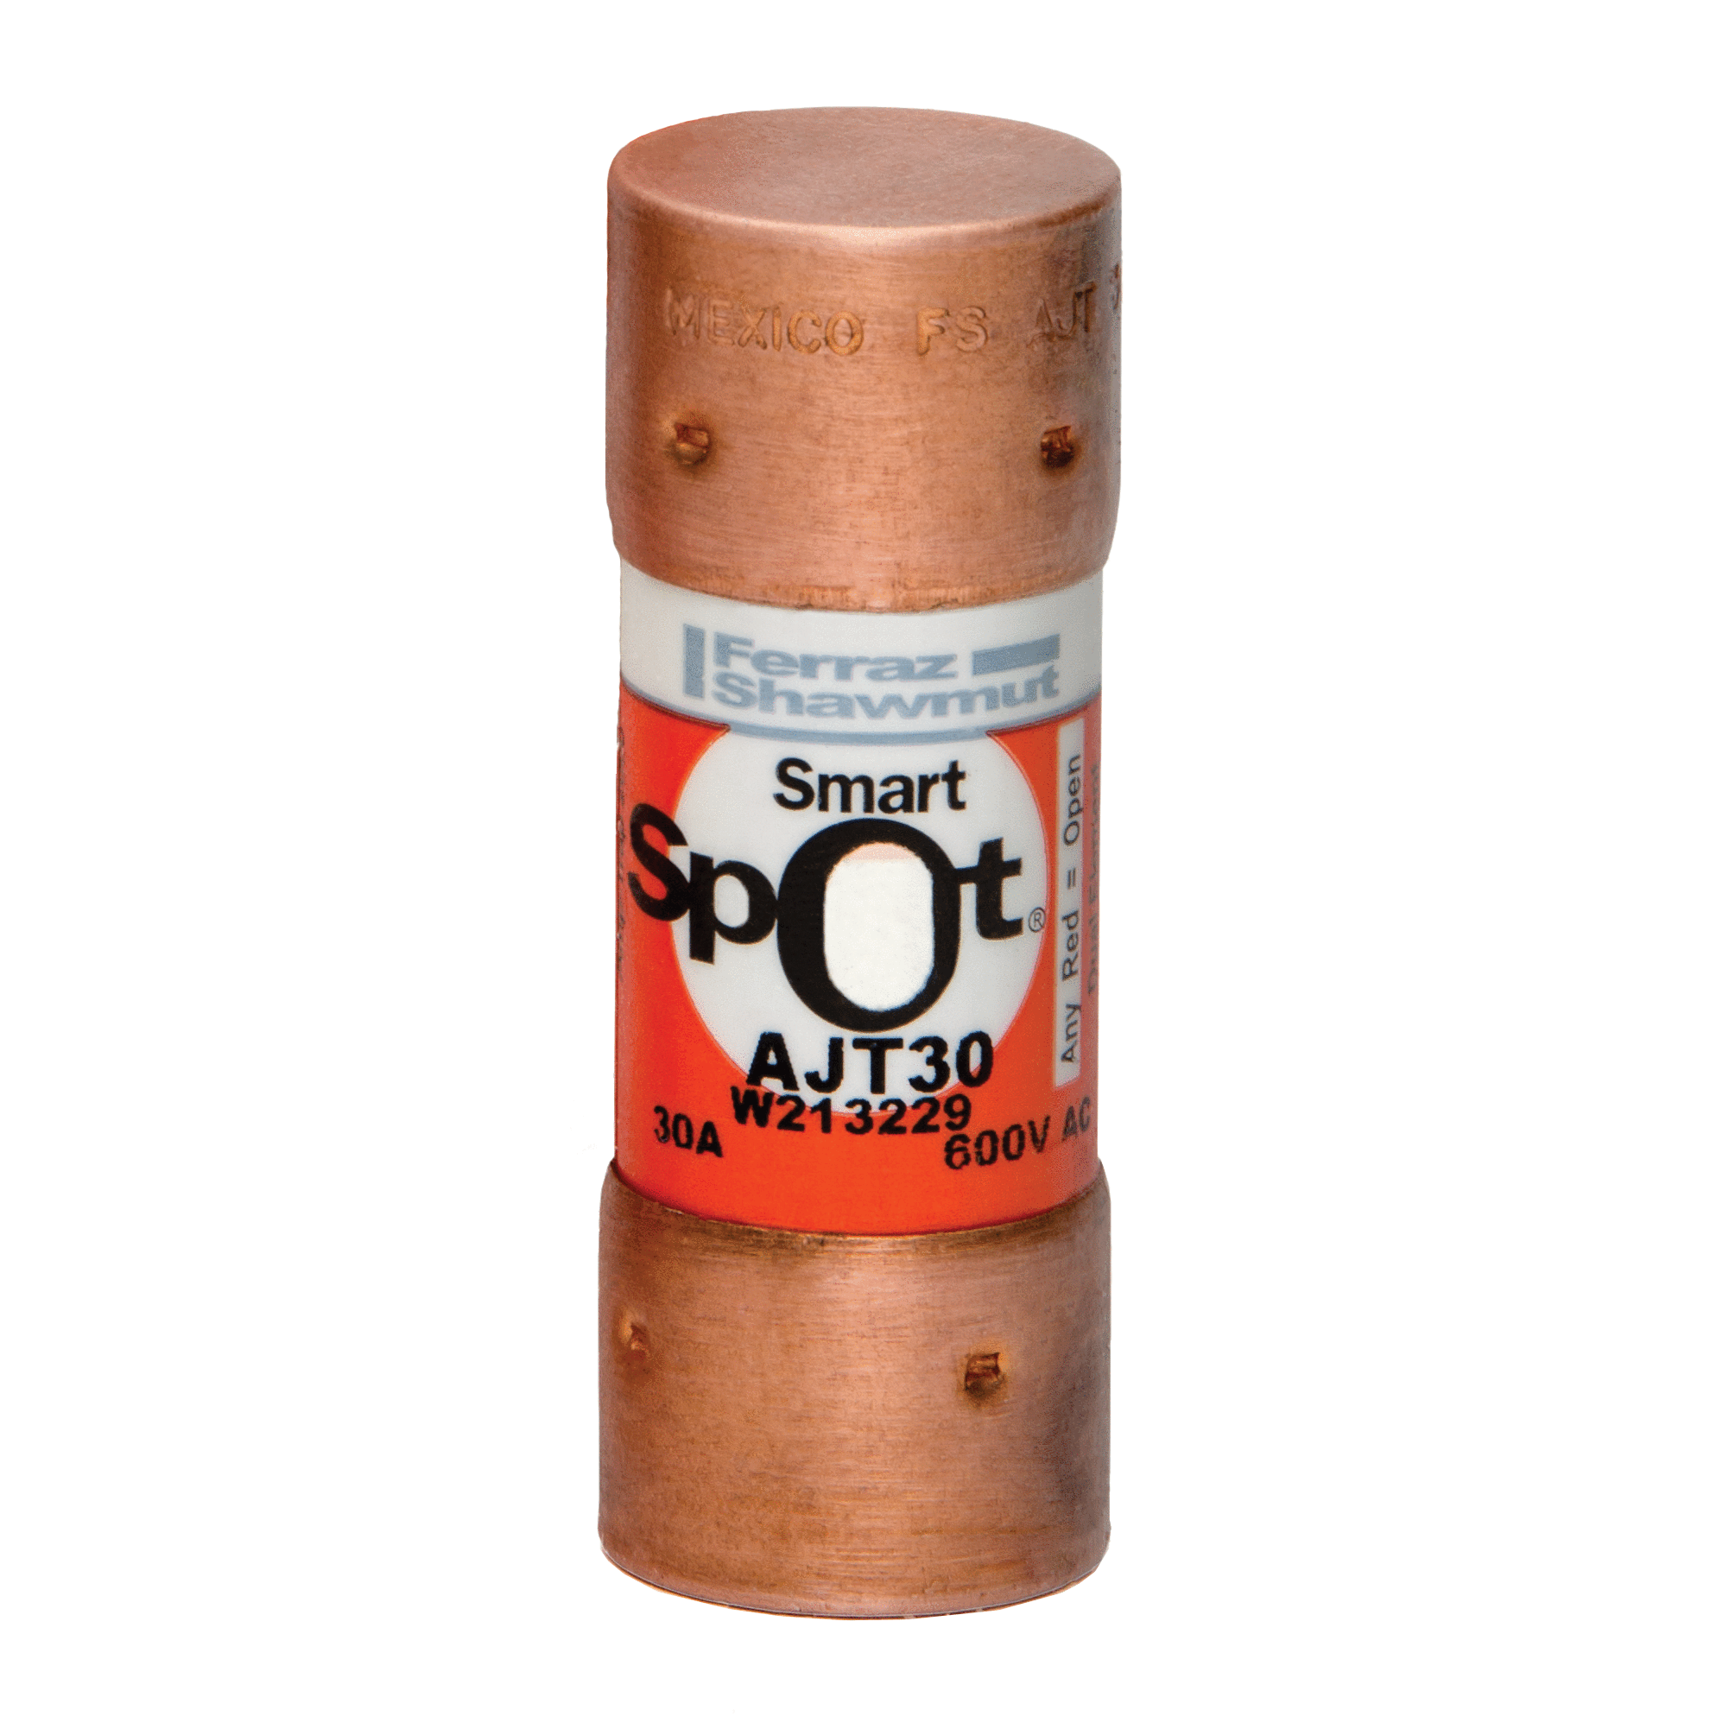
Amp-Trap 2000®
When there’s absolutely
no time for downtime

Slide 3
What’s the Cost of a Short Circuit?
Safety hazards for personnel
Damage to critical equipment
Downtime and lost productivity
Reduced profitability

Slide 4


Traditional Fuses Protect...
Electrical system from fire and explosion
Plant personnel from harm
What Protects...
  Equipment?
  Productivity?
  Profitability?

Slide 5
Amp-Trap 2000®
Family of fuses
  Provides Type “2” (No-Damage) protection
Type “2” (No-Damage) protection defined
  No fire or safety hazard
  No damage to components and equipment

Slide 6
How Do Amp-Trap 2000® Fuses Operate
Under Short Circuit Conditions?
Open in less than one-quarter cycle
Limit fault currents up to 300 kA – highly current limiting
Minimize let-thru current that flows downstream

Slide 7

That Means...
Improved safety
Virtually no damage to equipment
Reduced downtime
Greater uptime
Greater profitability

Slide 8

In Short, Amp-Trap 2000®
Protects Your Plant’s Assets
People
Plant equipment
Productivity
Profitability

Slide 9
What Else Does
Amp-Trap 2000® Offer?
Complete System Coverage
Class L
Class J
Class RK1
Class CC

Slide 10
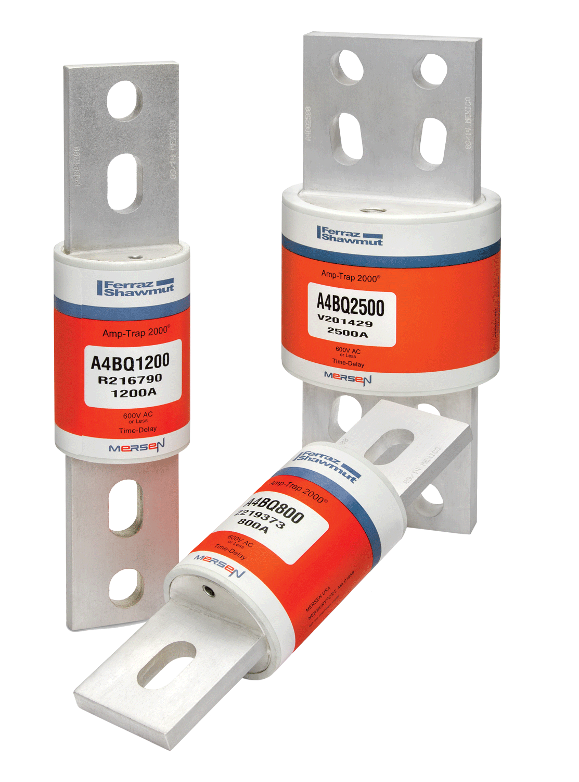
Class L – A4BQ Fuses
Protect service entrance branches
20% more current limiting than any other Class L fuse
Ratings from
601 to 6000 amps

Slide 11
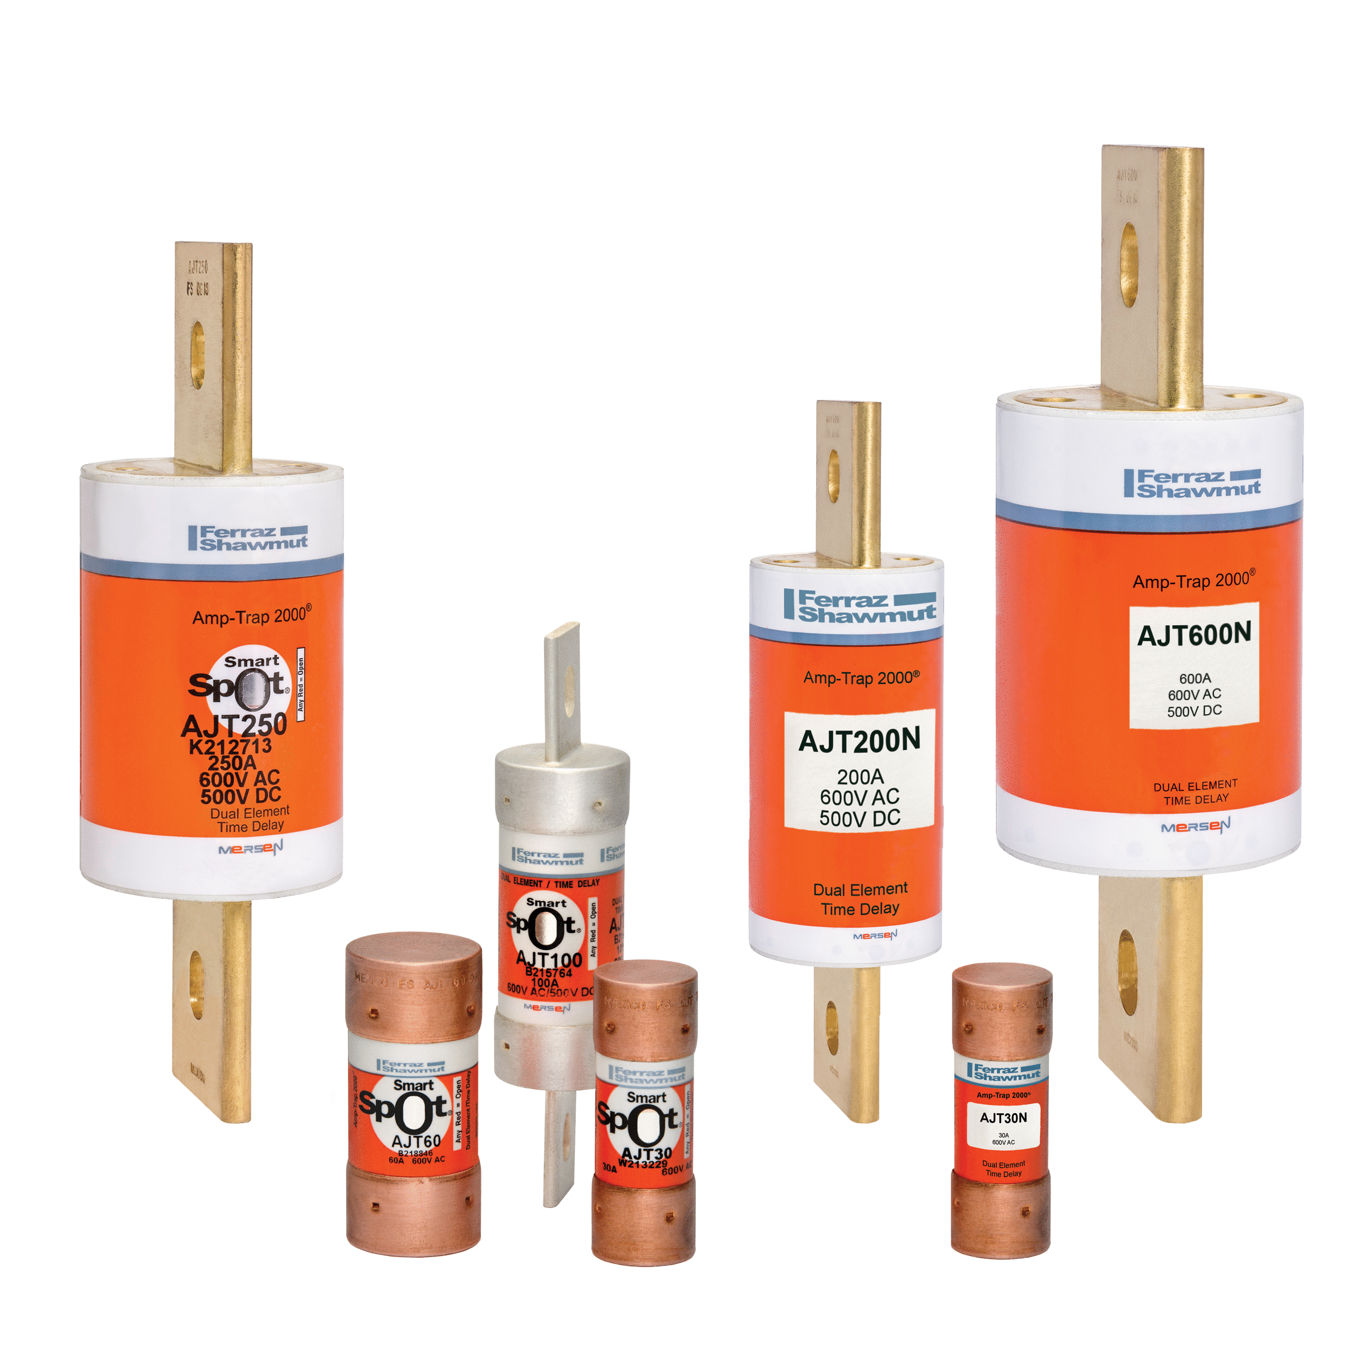
Class J – AJT Fuses
Compact fuses for new installations
Most current-limiting UL-class fuses
Ratings from
1 to 600 amps
Indicating and non-indicating versions

Slide 12
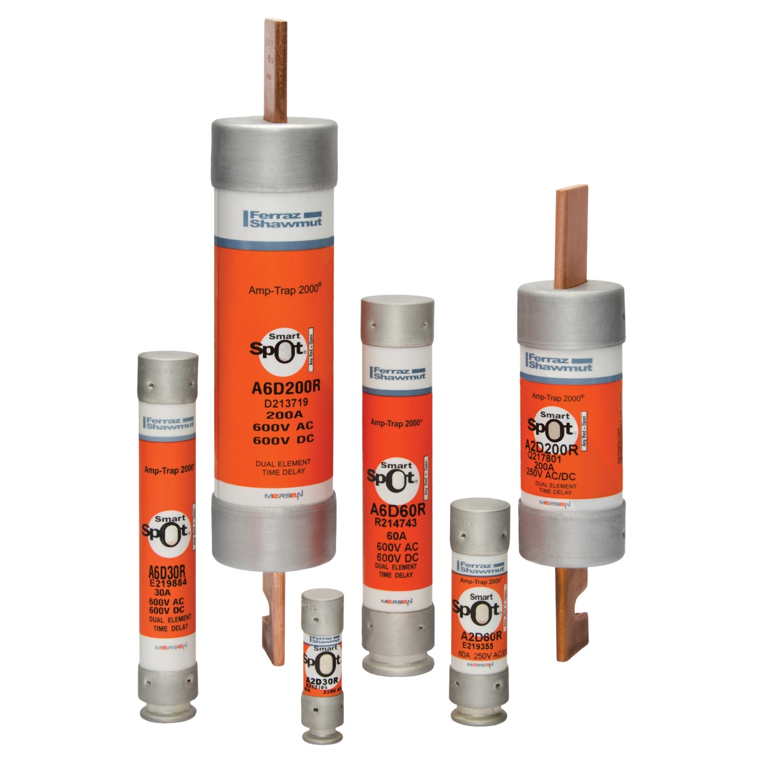
Class RK1 – A2D, A6D Fuses
Upgrade existing circuits to RK1 protection
Ratings from
1/10 to 600 amps

Slide 13
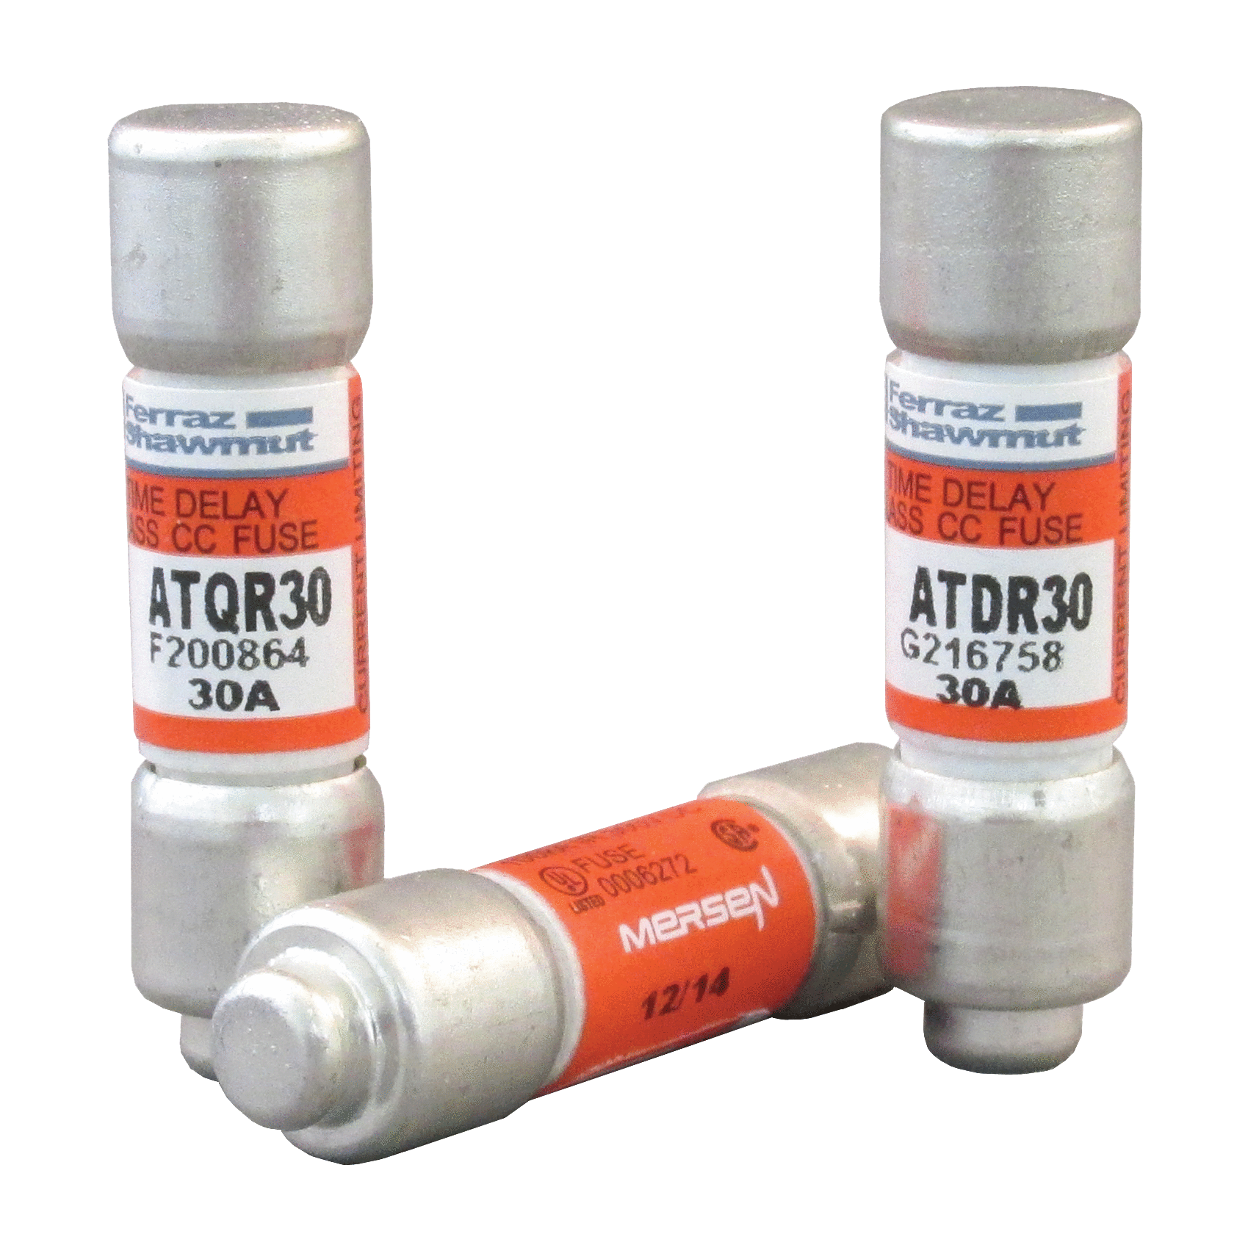
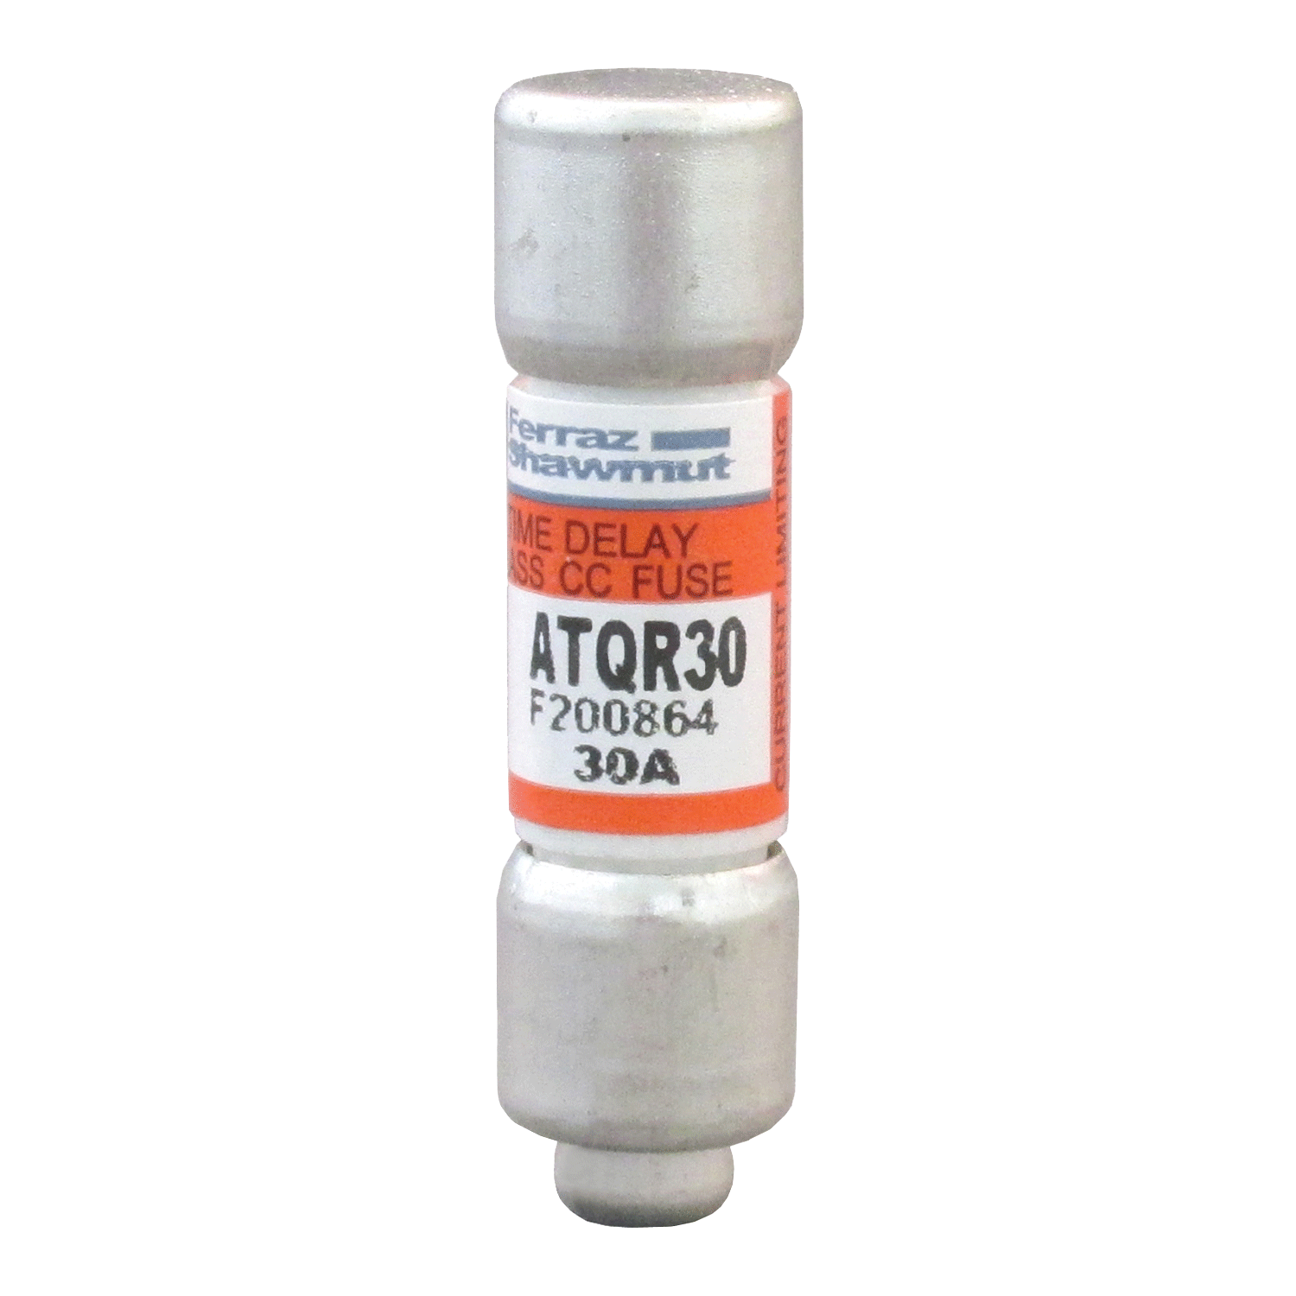
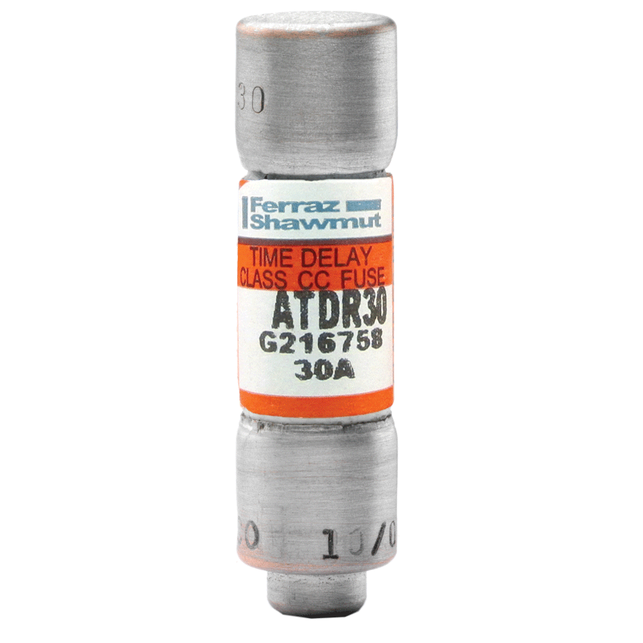
Class CC – ATDR, ATQR Fuses
For small motors and transformers
Optimal protection for sensitive components
Ratings from
0.1 to 30 amps

Slide 14
Amp-Trap 2000®
Also Offers...

Slide 15

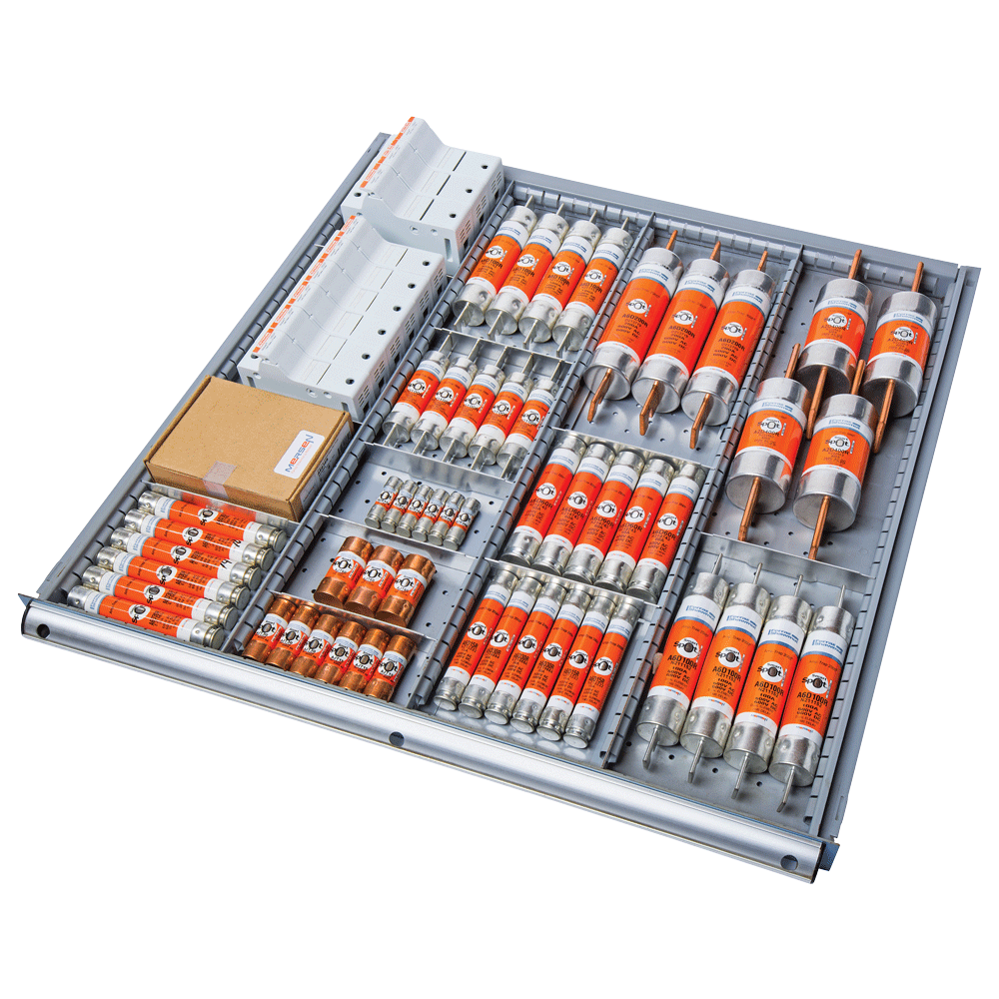
Reduced Inventory
One Amp-Trap® fuse replaces multiple SKUs
Reduces fuse inventory – typically by 25%
or more
Reduces inventory
costs
Reduces ordering,
stocking time

Slide 16
Time Delay
Allows fuse to withstand high inrush currents
Minimizes nuisance fuse opening
Simplifies fuse selection
Permits use of smaller amp ratings

Slide 17
Simple Selectivity
Achieved when ratio of upstream to downstream fuse ampere rating is 2-to-1 or greater for fuses over 60 amps
Minimizes nuisance shutdowns and blackouts

Slide 18
Improved Safety
High degree of current limitation protects people and equipment from short circuit damage
Rejection-style design helps avoid misapplications

Slide 19
Tomorrow’s Protection Today
Type “2” (No-Damage) protection is wave of the future
Amp-Trap 2000® meets today’s needs, tomorrow’s requirements

Slide 20
Wait … There’s More!

Slide 21

Find Open Fuses Faster With -

Slide 22
What is SmartSpot ®?
Innovative open-fuse indicator
Not just a new indicator, a new technology
Developed and patented by Mersen

Slide 23
SmartSpot ® Combines
Advanced materials technology
Unique, solid-body design
  Maintains fuse’s structural integrity
  Improves fuse safety and reliability
Proprietary manufacturing processes

Slide 24
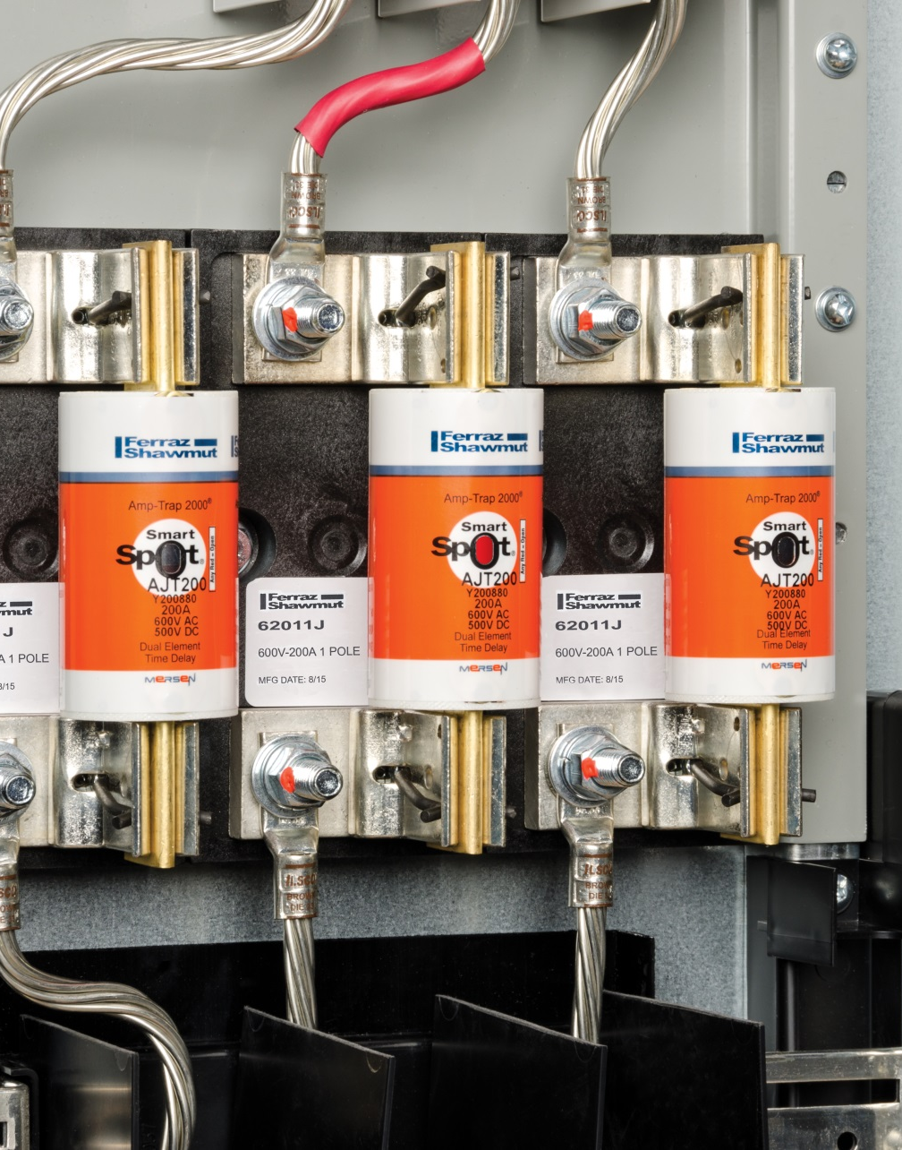
How Does SmartSpot ® Work?
In overcurrent conditions, immediately responds when main fuse link opens
Indicator turns eye-catching red
Stays red even after power is turned off
With SmartSpot
  “Any Red = Open”
  Open fuses easy to spot, even in
  crowded panel
  Problem circuit is quickly identified

Slide 25
SmartSpot ® Now Available on Amp-Trap 2000®
Class J, AJT fuses – 8 amps and up
Class RK1, A2D/A6D fuses – 8 amps and up

Slide 26
Amp-Trap 2000® and SmartSpot ®
Two more innovations from Mersen –
your circuit protection resource.

