Slide 1

Session 3: Fuse Construction & Performance

Slide 2
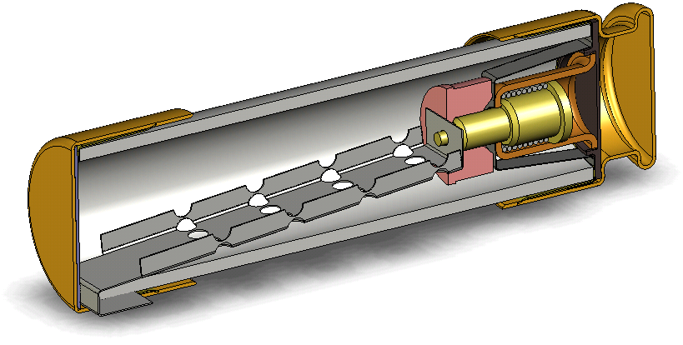
Agenda
UL/CSA low voltage fuse construction time-delay vs. non-time delay
Medium voltage fuse construction
Semiconductor/Highspeed fuse construction
Fuse performance and how it applies to motor and transformer protection
Notes:
Welcome to Ferraz Shawmut’s course on Fuse construction.

Slide 3
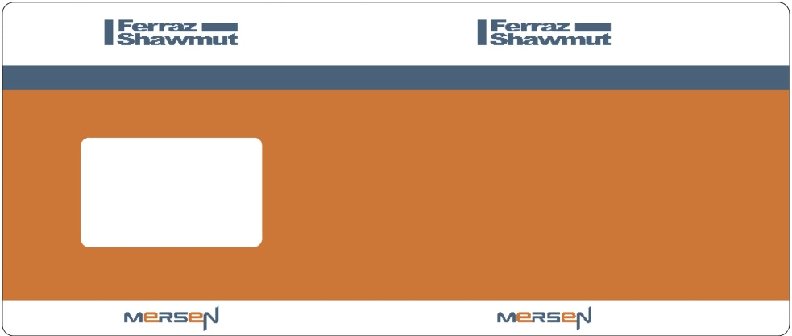
Fuse Label Template
Notes:
First lets take a look at a fuses label and notice it has three main ratings. The first is ampere rating (high light the 5000amp) which is the continuous current-carrying capability of a fuse under defined test conditions. It is important to remember that the ampere rating is under defined test conditions and most fuses can only be loaded to 80 percent of this rating. The second key rating is the voltage rating and is the maximum voltage at which the fuse is designed to operate (high light 600V AC), if the fuse is capable of being used on DC the DC rating will also be marked on the label. The third rating a fuse has is it’s Interrupting rating (high light 2000,000 IR) and is the maximum tested current a fuse can safely interrupt, which can be abbreviated as I.R. For fuses listed by Underwriters Laboratory it is required that they are labeled with the fuse class (Highlight Class L), that they are current limiting (Highlight current limiting) and the UL mark and a UL issue number (Highlight UL mark and issue No.). The Manufacturer’s name or logo will be on the label (Highlight Ferraz Shawmut) and if the fuse is Time delay/Dual element it will be listed on the label (Highlight Time Delay).

Slide 4
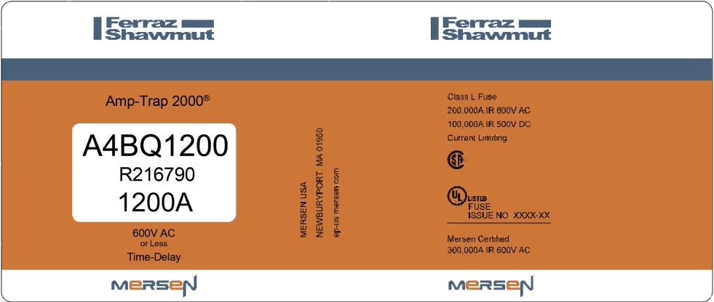
Fuse Label Template
Notes:
First lets take a look at a fuses label and notice it has three main ratings. The first is ampere rating (high light the 5000amp) which is the continuous current-carrying capability of a fuse under defined test conditions. It is important to remember that the ampere rating is under defined test conditions and most fuses can only be loaded to 80 percent of this rating. The second key rating is the voltage rating and is the maximum voltage at which the fuse is designed to operate (high light 600V AC), if the fuse is capable of being used on DC the DC rating will also be marked on the label. The third rating a fuse has is it’s Interrupting rating (high light 2000,000 IR) and is the maximum tested current a fuse can safely interrupt, which can be abbreviated as I.R. For fuses listed by Underwriters Laboratory it is required that they are labeled with the fuse class (Highlight Class L), that they are current limiting (Highlight current limiting) and the UL mark and a UL issue number (Highlight UL mark and issue No.). The Manufacturer’s name or logo will be on the label (Highlight Ferraz Shawmut) and if the fuse is Time delay/Dual element it will be listed on the label (Highlight Time Delay).

Slide 5
Fuse Label Template
Notes:
First lets take a look at a fuses label and notice it has three main ratings. The first is ampere rating (high light the 5000amp) which is the continuous current-carrying capability of a fuse under defined test conditions. It is important to remember that the ampere rating is under defined test conditions and most fuses can only be loaded to 80 percent of this rating. The second key rating is the voltage rating and is the maximum voltage at which the fuse is designed to operate (high light 600V AC), if the fuse is capable of being used on DC the DC rating will also be marked on the label. The third rating a fuse has is it’s Interrupting rating (high light 2000,000 IR) and is the maximum tested current a fuse can safely interrupt, which can be abbreviated as I.R. For fuses listed by Underwriters Laboratory it is required that they are labeled with the fuse class (Highlight Class L), that they are current limiting (Highlight current limiting) and the UL mark and a UL issue number (Highlight UL mark and issue No.). The Manufacturer’s name or logo will be on the label (Highlight Ferraz Shawmut) and if the fuse is Time delay/Dual element it will be listed on the label (Highlight Time Delay).

Slide 6
Fuse Label Template
Notes:
First lets take a look at a fuses label and notice it has three main ratings. The first is ampere rating (high light the 5000amp) which is the continuous current-carrying capability of a fuse under defined test conditions. It is important to remember that the ampere rating is under defined test conditions and most fuses can only be loaded to 80 percent of this rating. The second key rating is the voltage rating and is the maximum voltage at which the fuse is designed to operate (high light 600V AC), if the fuse is capable of being used on DC the DC rating will also be marked on the label. The third rating a fuse has is it’s Interrupting rating (high light 2000,000 IR) and is the maximum tested current a fuse can safely interrupt, which can be abbreviated as I.R. For fuses listed by Underwriters Laboratory it is required that they are labeled with the fuse class (Highlight Class L), that they are current limiting (Highlight current limiting) and the UL mark and a UL issue number (Highlight UL mark and issue No.). The Manufacturer’s name or logo will be on the label (Highlight Ferraz Shawmut) and if the fuse is Time delay/Dual element it will be listed on the label (Highlight Time Delay).

Slide 7
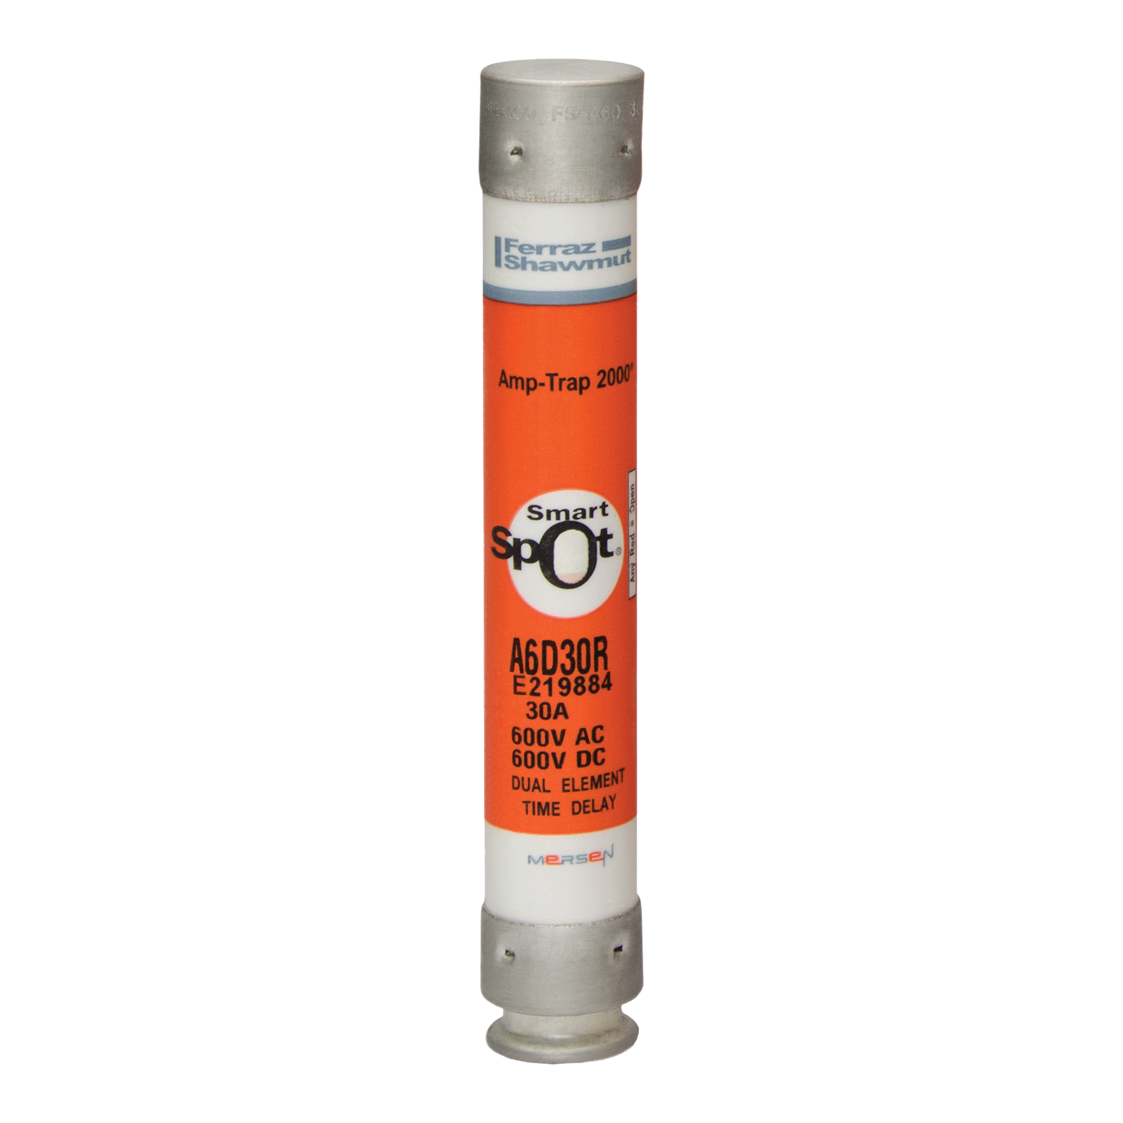
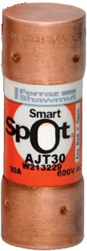
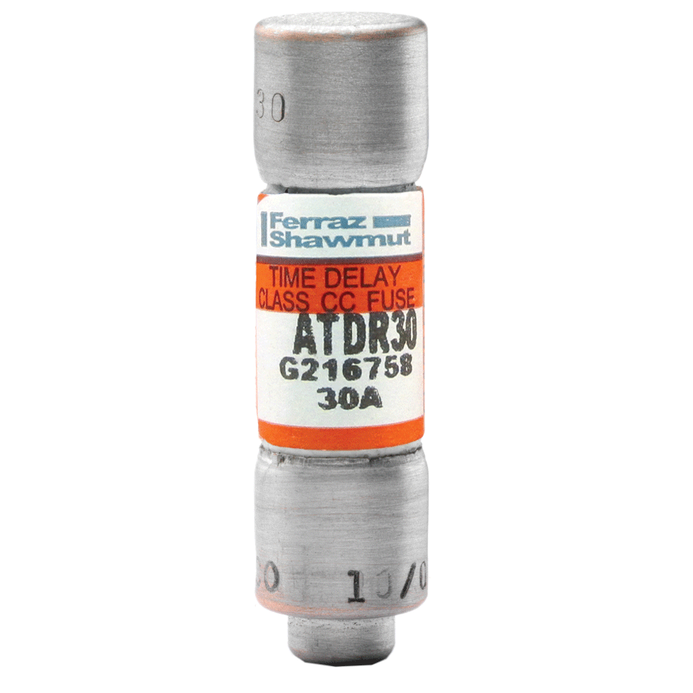
Notes:
These fuses are called ferrule or cylindrical fuses current limiting which means they limit both the magnitude and the duration of fault current under short circuit conditions. They are all rated for 30 amps continuous and are all Rejection fuses which are Current limiting fuses with a high interrupting rating and unique dimensions or mounting provisions.

Slide 8
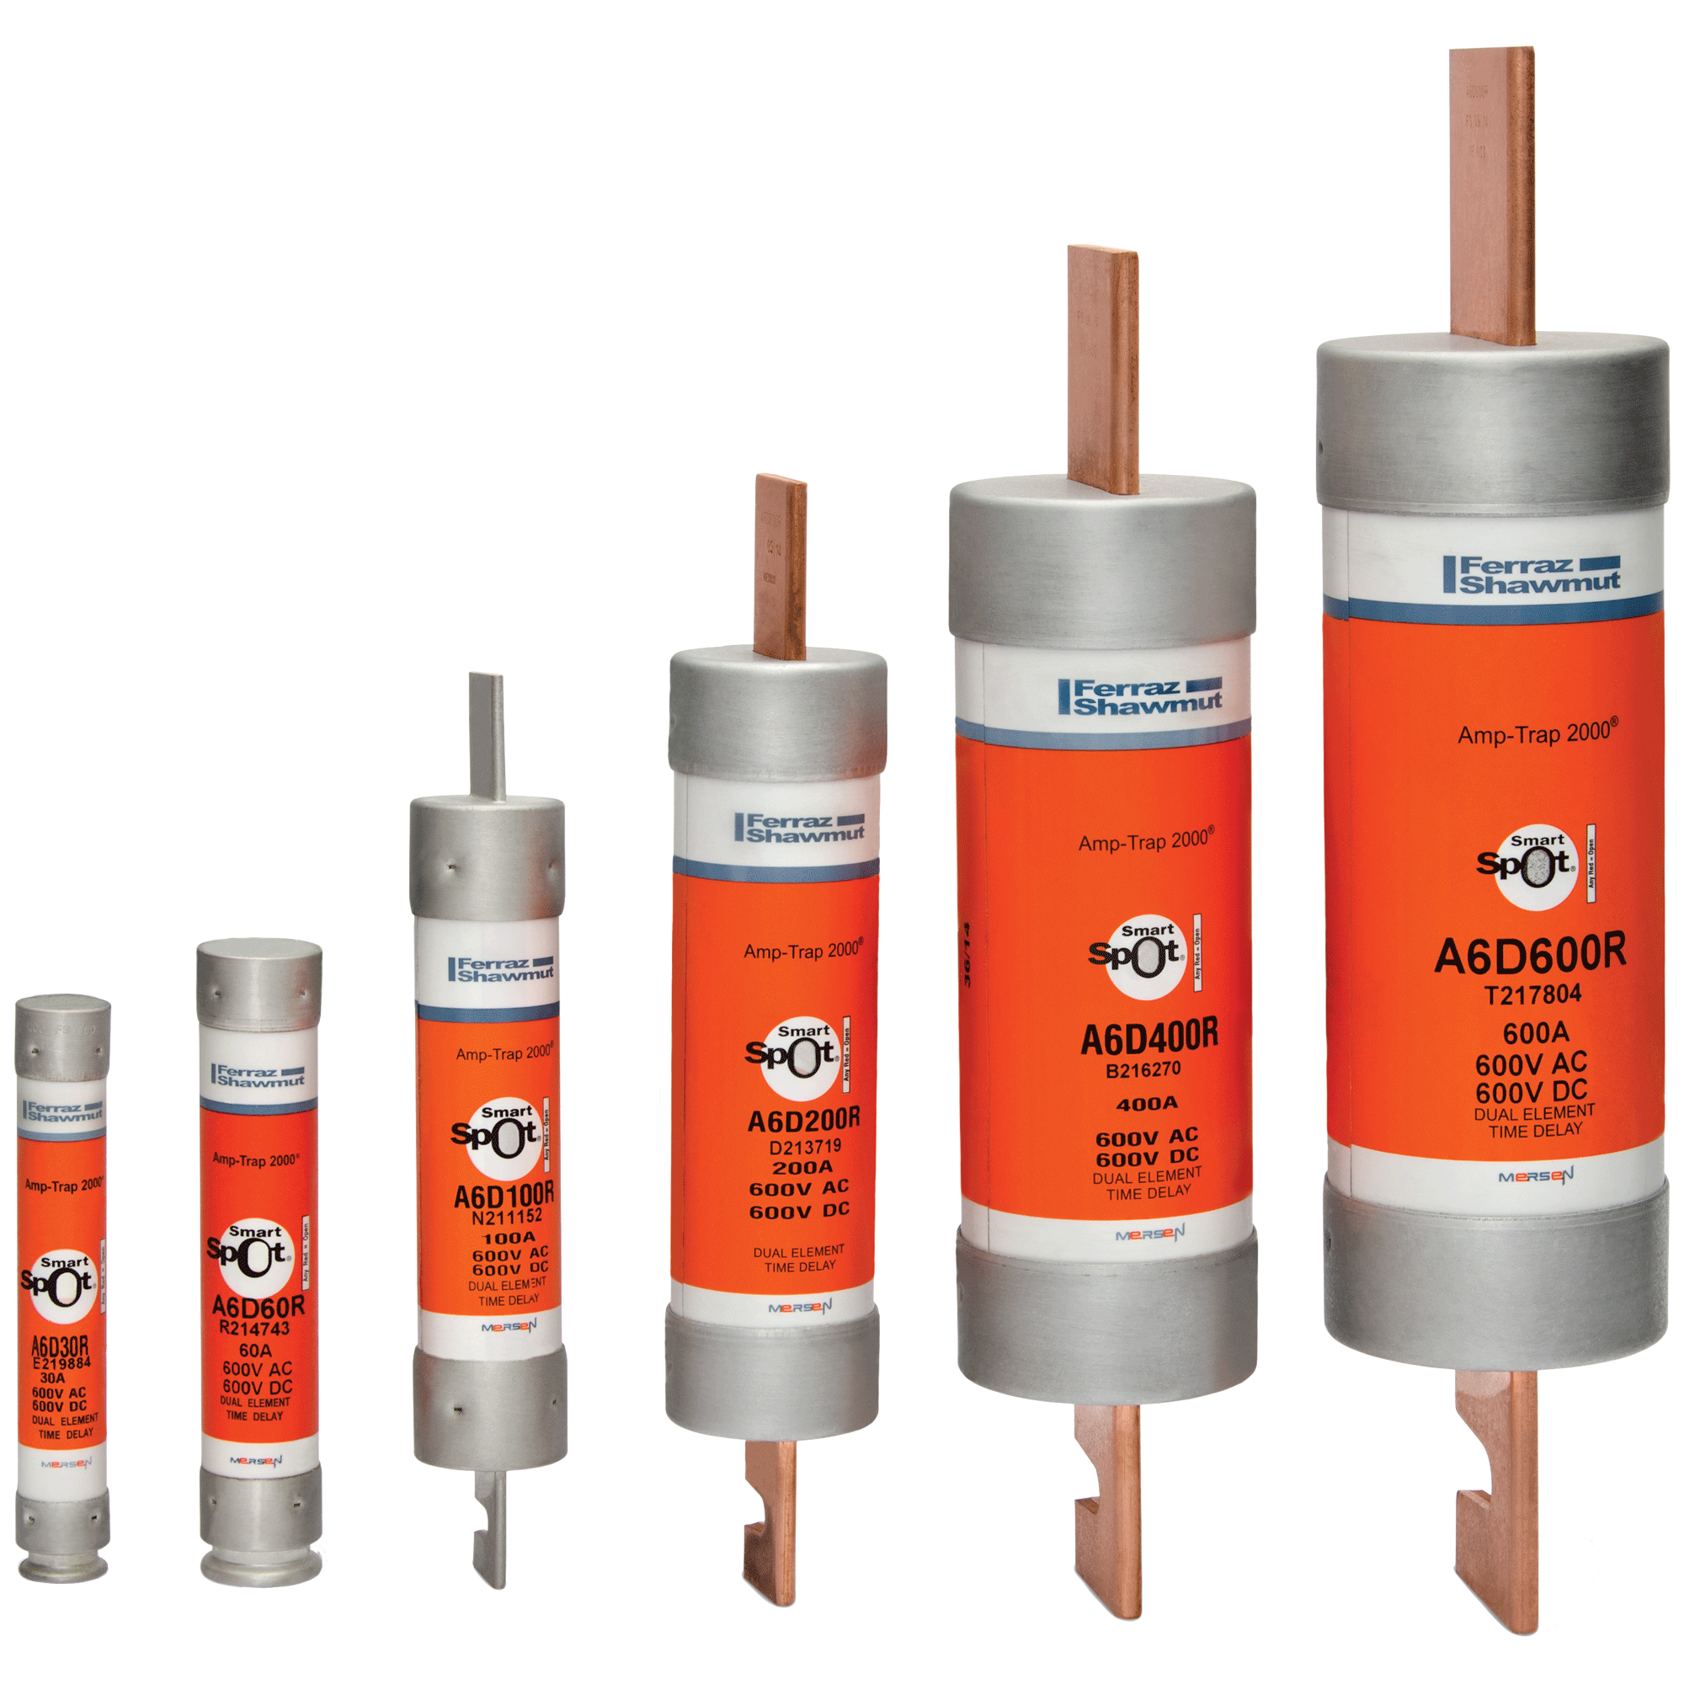
Notes:
UL listed fuses below 600 amps have six different body sizes. The first two are 0 to 30 amps and 31 to 60 amps which are always ferrule type fuse. The last four body sizes are bladed type fuses and they are: 61 to 100 amps, 101 to 200 amps, 201 to 400 amps and 401 to 600 amps.

Slide 9
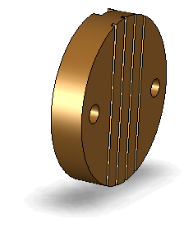
Bladed Fuse Construction
Block
Notes:
We will building a bladed fuse using the blade-block method. We start with the block

Slide 10
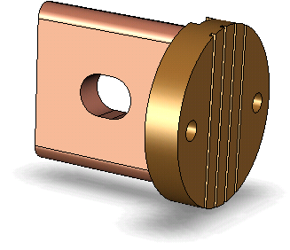
Bladed Fuse Construction
Blade
Notes:
Then a blade is brazed to the block to create the blade-block terminal assembly.

Slide 11
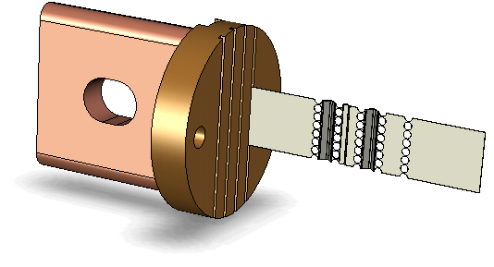
Bladed Fuse Construction
Element
Notes:
Next the elements are soldered to the terminal, the more elements in a fuse the higher the ampacity the fuse has. (should be said over the nest 4 slides)

Slide 12
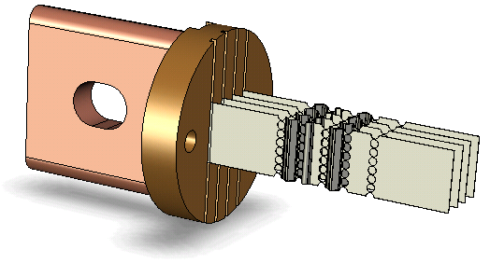
Bladed Fuse Construction
Elements

Slide 13
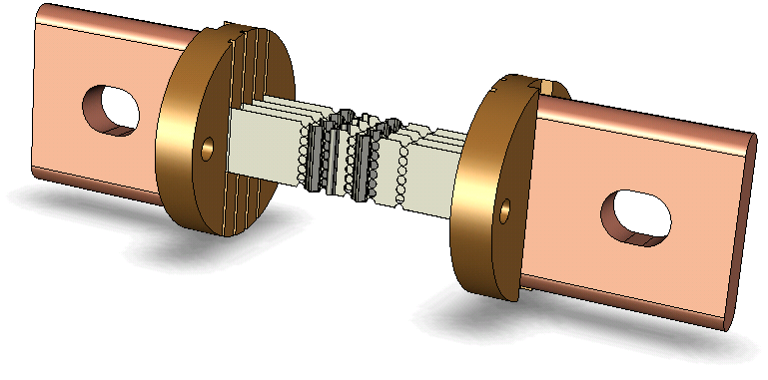
Bladed Fuse Construction
Blade-Block assembly
Notes:
Then the other Blade-Block terminal assembly is soldered to the elements.

Slide 14
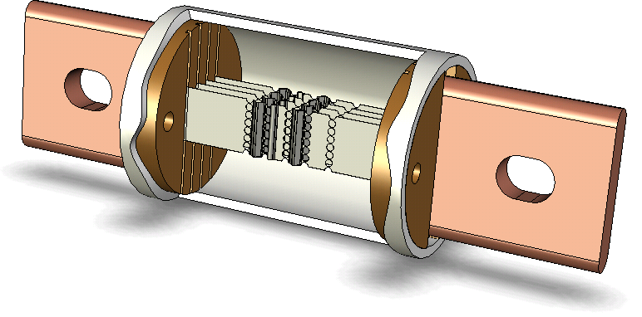
Bladed Fuse Construction
Body
Notes:
The fuse body is put on and then staked into place. Fuse bodies can be made from a number of different things like paper and ceramic but the most common is GMG a form of fiberglass.

Slide 15
Bladed Fuse Construction
Filler
Notes:
****FILL THE BODY WITH SAND****
A filler is then added which is usually a quartz sand. The filler acts as an insulator when the elements melt.

Slide 16
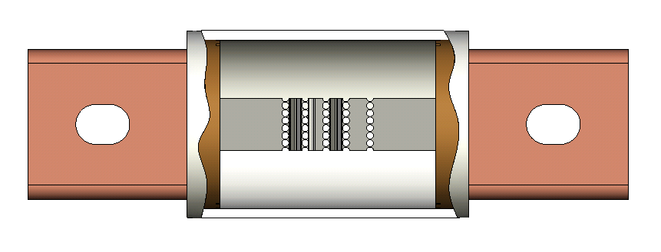
Time-Delay/Dual Element
Notes:
When we talk about time delay fuses we almost always hear dual element. Dual element is referring to the construction methods used to achieve a time delay. There are two main ways to make a dual element time delay fuse. Fuses using the “M” effect are constructed in the same way as a fast acting fuse however they use a tin overlay near the center of each element. When heated the tin migrates in to the the element causing it to melt at a lower temperature.

Slide 17
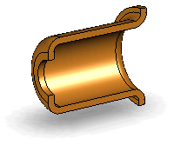
Ferrule Fuse Construction
Spring and Plunger Housing
Notes:
The second way is a spring and plunger assembly, which is typically used in Ferrule fuses. It starts with and spring and plunger housing.

Slide 18
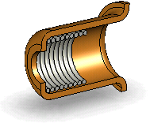
Ferrule Fuse Construction
Spring
Notes:
Then a spring is added which will retract the plunger.

Slide 19
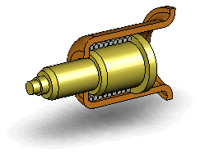
Ferrule Fuse Construction
Plunger
Notes:
And the plunger is inserted.

Slide 20
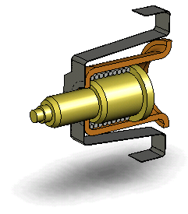
Ferrule Fuse Construction
Heater
Notes:
A heater is added to the outside of the plunger assembly which completes the spring and plunger assembly. During an overload the heater helps concentrate the heat to the plunger.

Slide 21
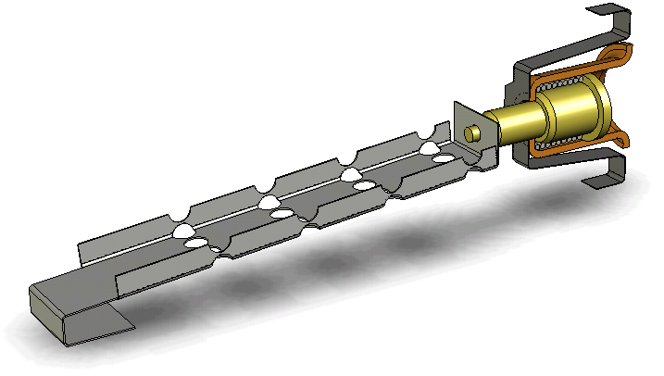
Ferrule Fuse Construction
Eutectic Solder
Short Circuit Element
Notes:
****ADD SOLDER TO THE JOINT****
Then a short circuit element is soldered to the plunger with eutectic solder. Eutectic solder is temperature sensitive and will melt at a specified temperature. Now the dual element is complete.

Slide 22
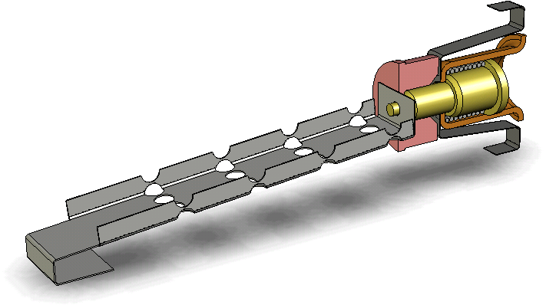
Ferrule Fuse Construction
Grommet
Notes:
A rubber grommet is added around the plunger to keep the quartz sand from interfering with it’s operation.

Slide 23
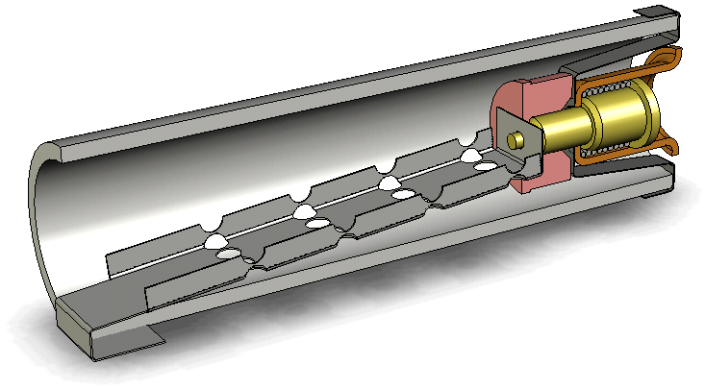
Ferrule Fuse Construction
Body
Notes:
The element assembly is then slid into a fuse body.

Slide 24
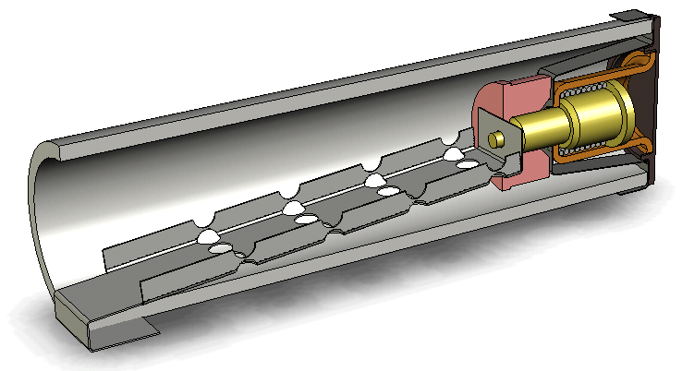
Ferrule Fuse Construction
Fiber Washer
Notes:
A fiber washer is placed on the plunger end to help prevent the fill from leaking out.

Slide 25
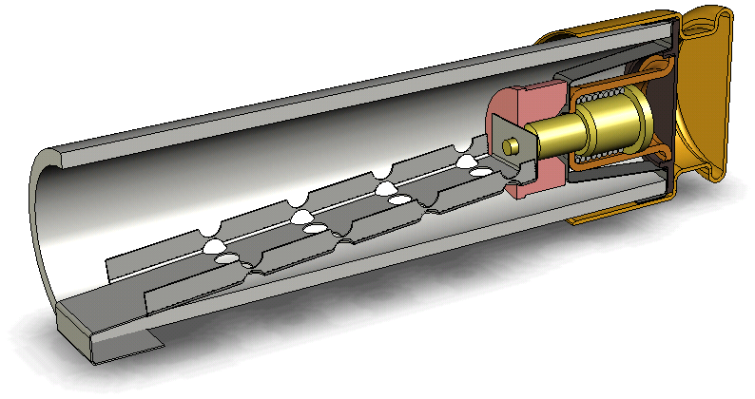
Ferrule Fuse Construction
Rejection Ferrule
Notes:
The rejection ferrule is then put on and crimped.

Slide 26
Ferrule Fuse Construction
Filler
Notes:
****FILL THE BODY WITH SAND****
The body is then filled with a quartz sand.

Slide 27
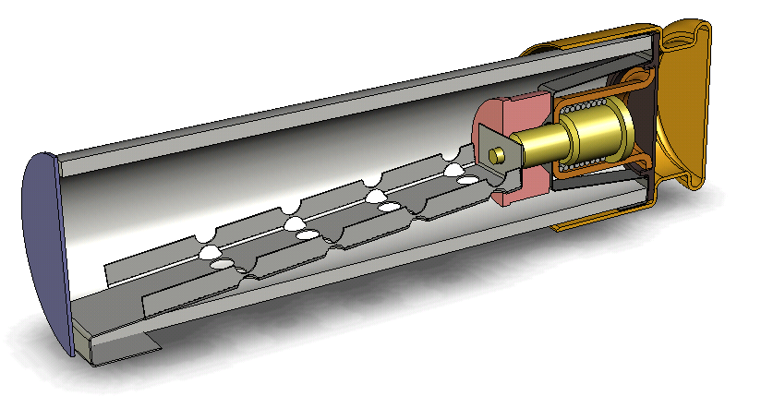
Ferrule Fuse Construction
Fiber Washer
Notes:
A fiber washer is added to the open side.

Slide 28
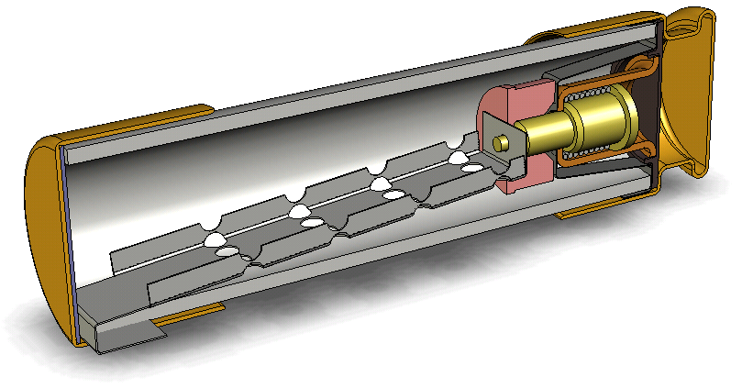
Ferrule Fuse Construction
Non-rejection Ferrule
Notes:
And the non-rejection ferrule is put on and crimped.

Slide 29
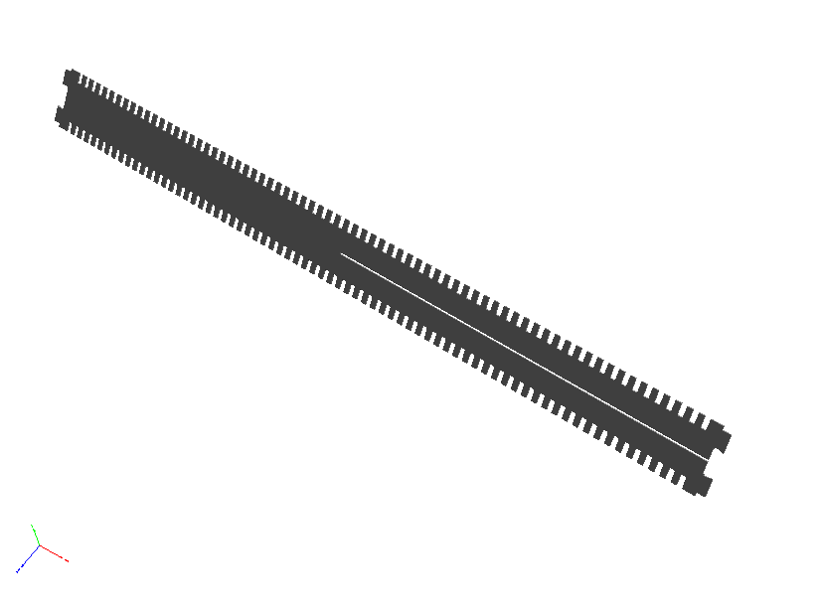
Medium Voltage: 9F59CBD150 – 17.2kA OSP

Slide 30
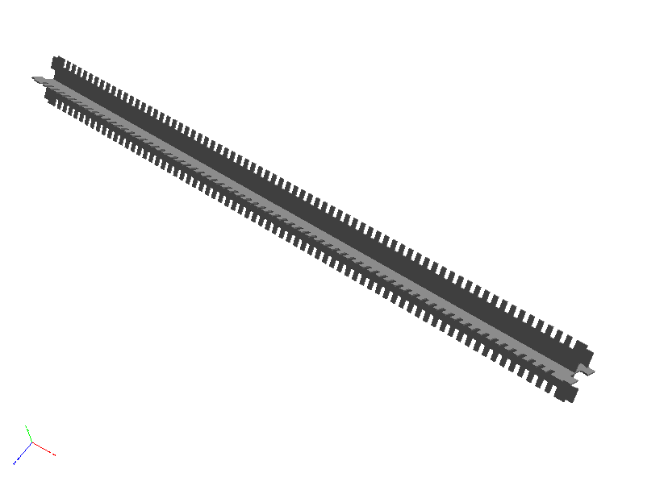
Medium Voltage: 9F59CBD150 – 17.2kA OSP

Slide 31
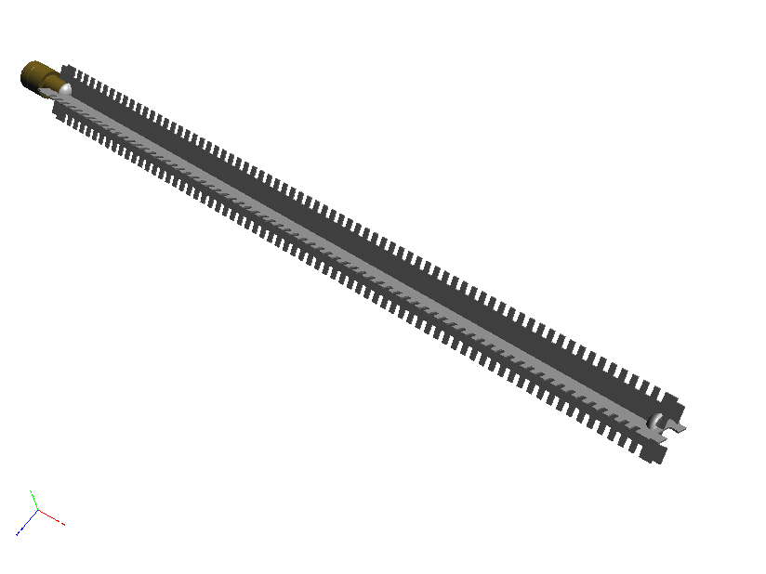
Medium Voltage: 9F59CBD150 – 17.2kA OSP

Slide 32
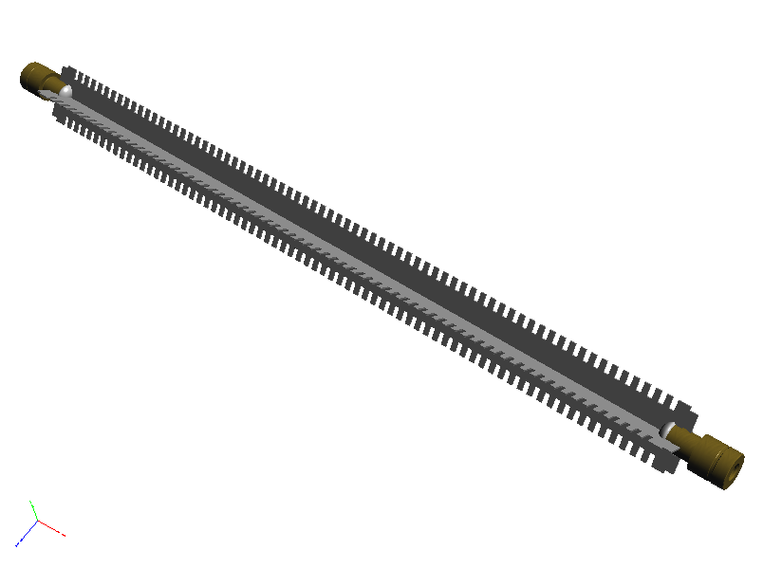
Medium Voltage: 9F59CBD150 – 17.2kA OSP

Slide 33

Medium Voltage: 9F59CBD150 – 17.2kA OSP

Slide 34
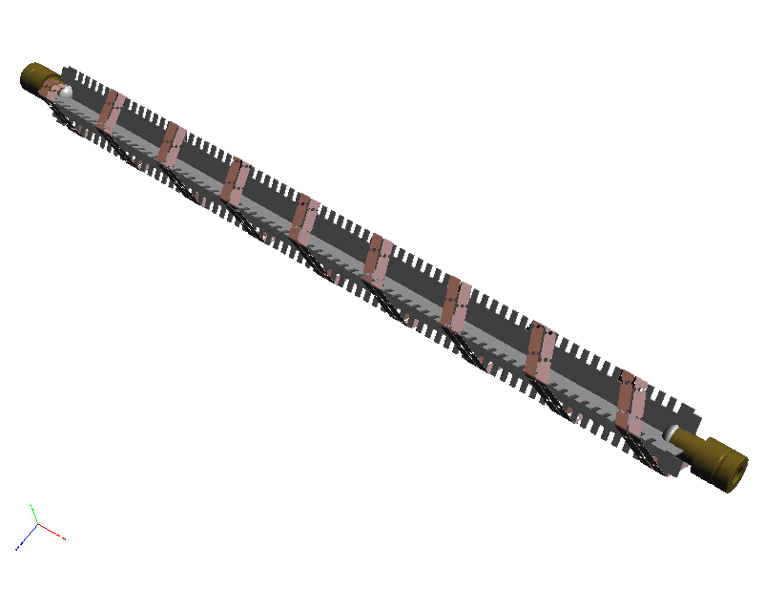
Medium Voltage: 9F59CBD150 – 17.2kA OSP

Slide 35
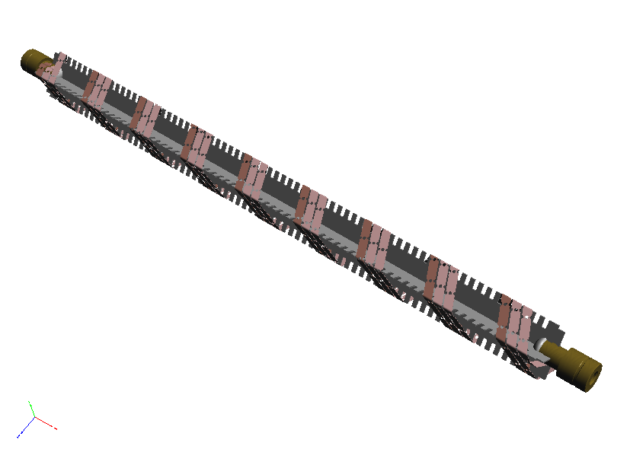
Medium Voltage: 9F59CBD150 – 17.2kA OSP

Slide 36

Medium Voltage: 9F59CBD150 – 17.2kA OSP

Slide 37
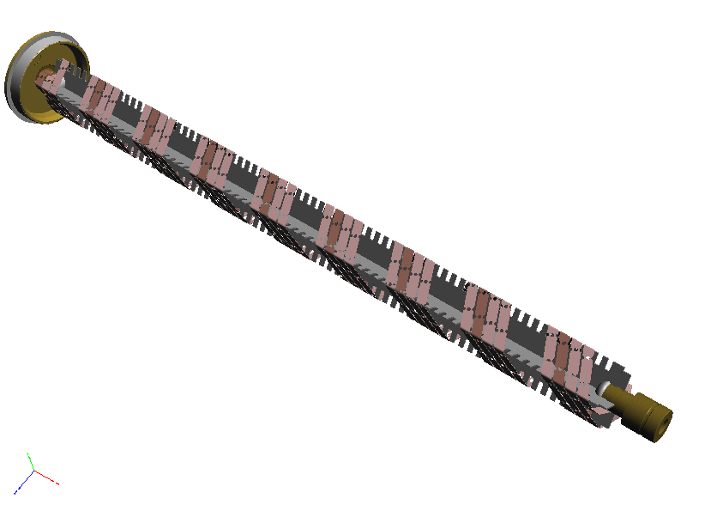
Medium Voltage: 9F59CBD150 – 17.2kA OSP

Slide 38
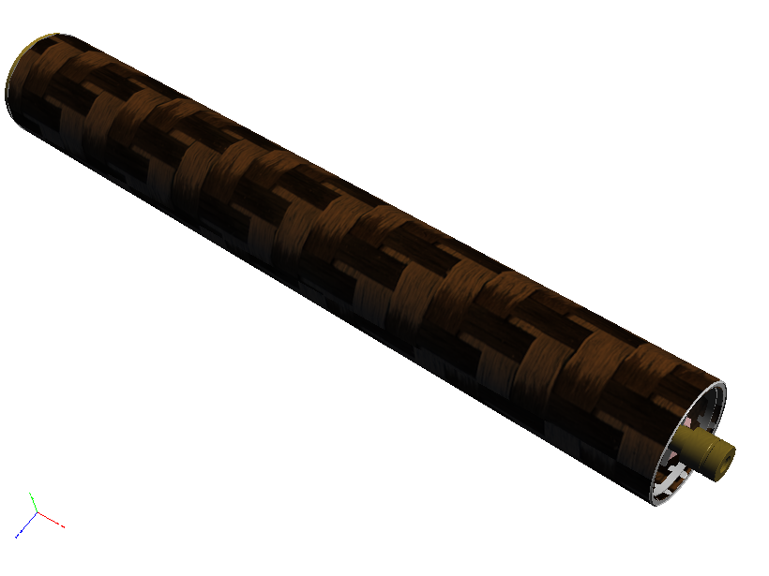
Medium Voltage: 9F59CBD150 – 17.2kA OSP

Slide 39

Medium Voltage: 9F59CBD150 – 17.2kA OSP

Slide 40

Medium Voltage: 9F59CBD150 – 17.2kA OSP

Slide 41
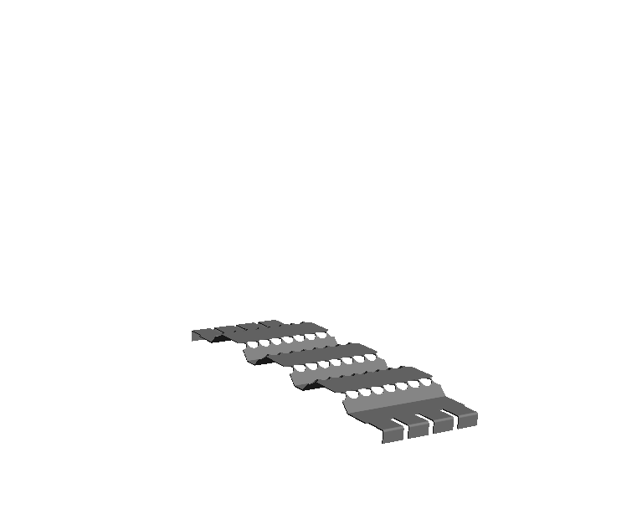
PSC Semiconductor Fuse

Slide 42
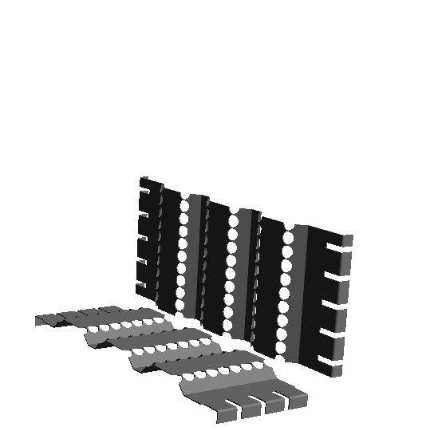
PSC Semiconductor Fuse

Slide 43
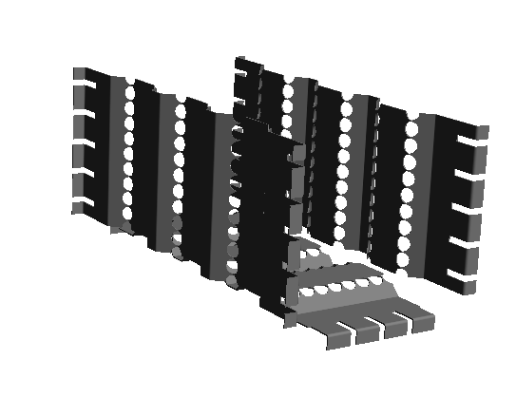
PSC Semiconductor Fuse

Slide 44
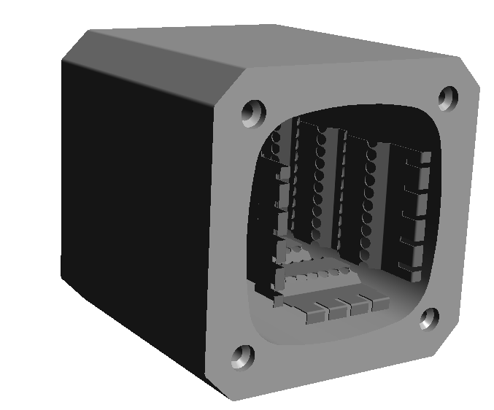
PSC Semiconductor Fuse

Slide 45
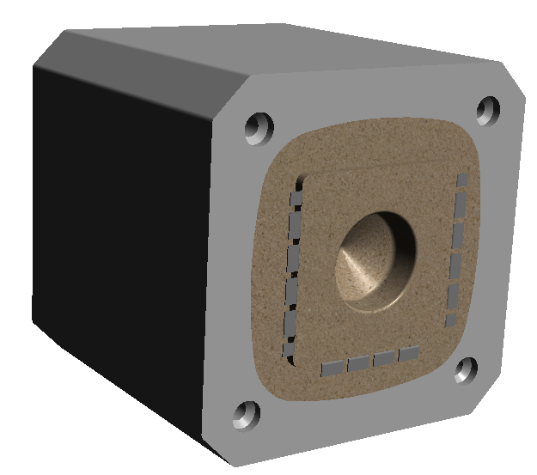
PSC Semiconductor Fuse

Slide 46
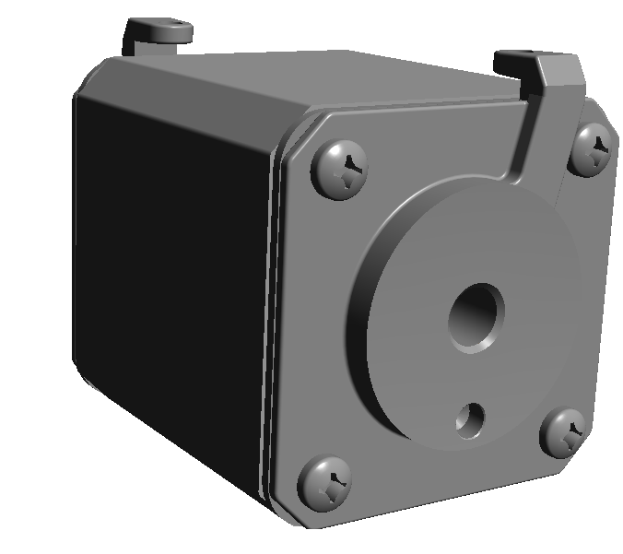
PSC Semiconductor Fuse

Slide 47
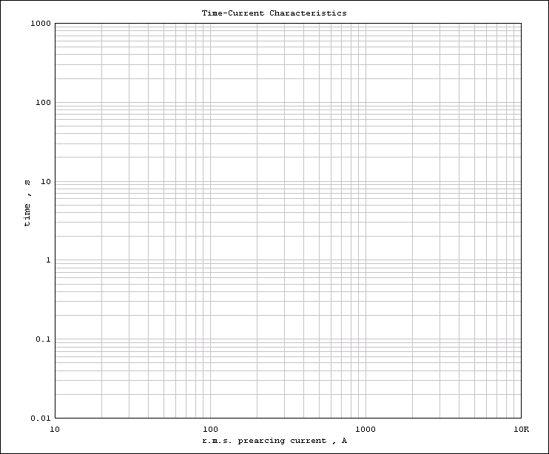
What is this?
AJT100
Notes:
Here is an average melting time current curve for the AJT100. Along the bottom we have available R.M.S current which increases as we move from left to right. On the side is the time for the fuse to open in seconds and it increases as we move up. Once we find the available R.M.S fault current on the bottom, we follow it up until we hit the fuse curve in red and then over to read how long it will take the fuse to open. In our example, if an AJT100 has 400 amps R.M.S applied to it, it will open in 30 seconds.

Slide 48
Anyone Know what the definition for time delay is?
AJT100
Notes:
Here is an average melting time current curve for the AJT100. Along the bottom we have available R.M.S current which increases as we move from left to right. On the side is the time for the fuse to open in seconds and it increases as we move up. Once we find the available R.M.S fault current on the bottom, we follow it up until we hit the fuse curve in red and then over to read how long it will take the fuse to open. In our example, if an AJT100 has 400 amps R.M.S applied to it, it will open in 30 seconds.

Slide 49
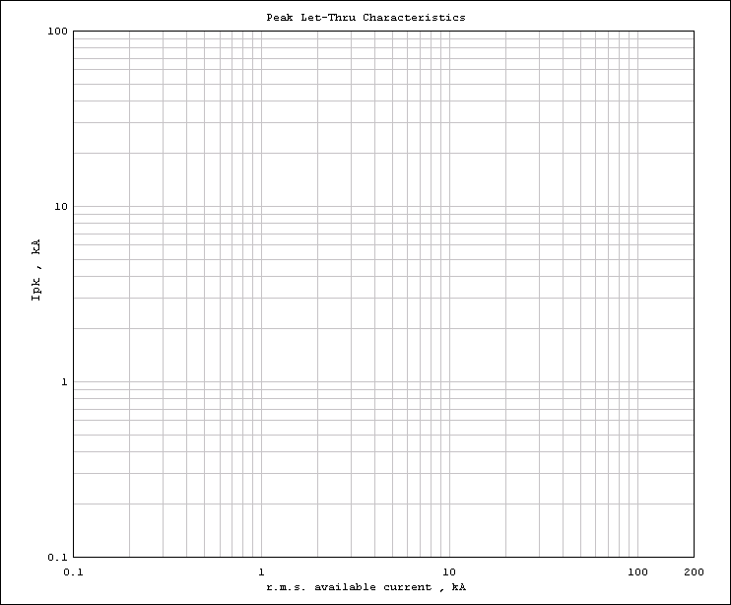
What is this?
AJT100

Slide 50
How to quickly read a Peak Let-Thru curve
AJT100

Slide 51
So what is it we are trying to do with the fuse?
Full Load Current (FLA)
Fuse Let-Thru Current
Available Fault Current
Notes:
Now that we know how to read fuse curves let’s take a look at a building that has had a short circuit. In green is our normal operating current known as Full load current, in red is the maximum available fault current in our building and in blue is the fuse let-thru current. Notice that the fuse current is higher than the Full load current but much lower than the available fault current.

Slide 52
Current Limitation Comparison
Class RK5
Not to Scale
Class RK1
Class J & T
Full Load Current (FLA)
Available Fault Current
Notes:
Now that we know how to read the two main types of fuse curves let’s take a look at how current-limiting fuses really work.(click) In green, is our normal operating current known as Full Load current. (click)In red, is the maximum available fault current that could flow if an abnormal condition were to occur. (click)And in blue, is the fuse’s let-thru current. Notice that the fuse’s let-thru current is higher than the Full Load current but is still much lower than the available fault current. In this case, the fuse will clear the fault current in less than ½ (half) cycle.

Slide 53
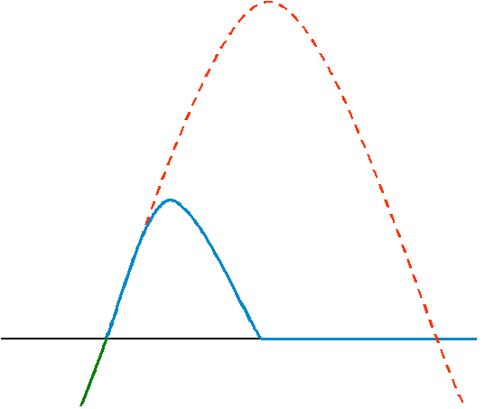
Full Load Current (FLA)
Peak Let-Thru Current
Fuse Let-Thru Current
Available Fault Current
Notes:
Let’s take a closer look at the fuse let-thru current. We can find how much peak current the fuse will let-thru by measuring from zero to the waves absolute peak. This is how Peak let-thru curves are created.

Slide 54
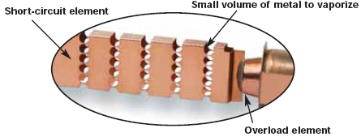
Peak Let-Thru Current
Available Fault Current
Melting I²t
Notes:
The melting time is when the fuse curve is increasing to the absolute peak. This is the time that the element is heating up and melting. Ampere Squared Seconds also known as I – squared – t is a measure of thermal energy associated with current. The melting I – squared – t is found by calculating the area under the curve during the melting time.

Slide 55
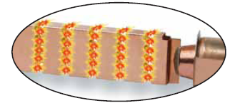
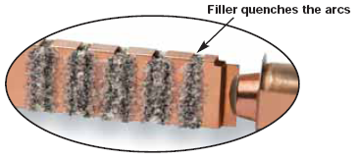
Peak Let-Thru Current
Available Fault Current
Melting I²t
Clearing I²t
Notes:
After the fuse current reaches its peak and starts to go back down to zero, it is called the arcing time. Again the arcing I – squared – t is found by calculating the area under the curve. The total clearing I – squared – t is the sum of both the melting I – squared – t and clearing I – squared – t .

Slide 56
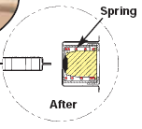
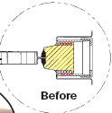
Full Load Current (FLA)
Fuse Let-Thru Current
Notes:
A fuse will operate much differently on an overload and will not open quickly. Again we have our full load current in green and our fuse let-thru current in blue. We can see that our building will see the full overload current for several minutes before the fuse opens.

Slide 57
Typical Motor Characteristic
Locked Rotor Current (LRC)
Not to Scale
Full Load Current (FLA)
Typically 2-10 seconds
Notes:
When an electric motor starts it draws a (click)high current for a short period of time. This is called the “locked rotor current” or inrush current and it is typically around 600 percent of the motor Full Load current for 2 to 10 seconds. Once the motor reaches its full speed the current drops back down to the Full Load current. (click)We can represent a motor starting by drawing a line across the peaks of the sine wave.

Slide 58
Time-Delay vs. Fast Acting
A4J100
A4J200
NEMA Class 20 overload relay
AJT100
X
Notes:
(click)Here we will look at both a time-delay AJT100 and a non-time delay A4J100 versus our motor starting current that is being used with a NEMA class 20 overload relay. Both fuses are sized at 150%, which is with in the NEC maximum values. (click)We can clearly see that the A4J100 will open before the motor fully starts, while the time-delay AJT100 will allow the motor to start completely. (click)If we size the A4J per the NEC maximum of 300% will have to use a 200Amp fuse, which will allow the motor to start. If at 100 seconds the motor is overloaded to 100 amps we can see that the overload relay will open much faster then the fuse.

Slide 59
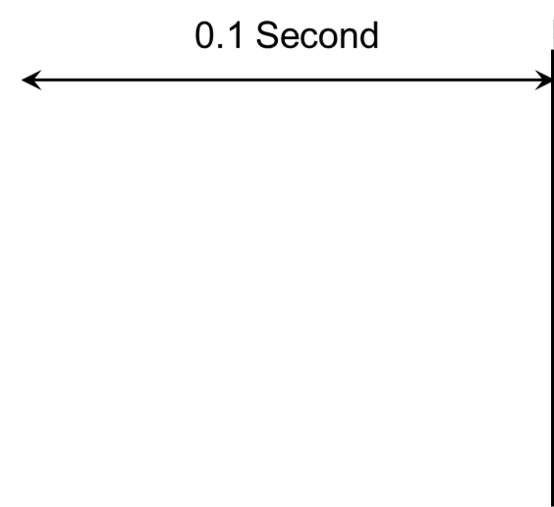

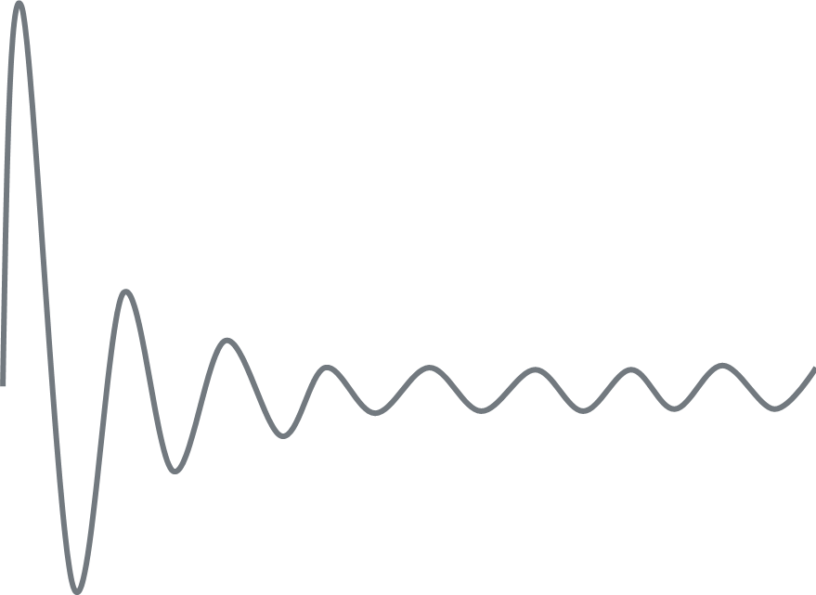
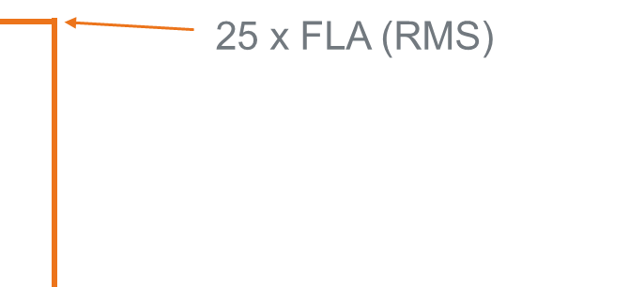



Transformer Characteristics
12 X FLA (RMS)
Notes:
When a transformer is energized, there is a large inrush current on the primary side which is greatest during the first half cycle approximately 0.01 seconds. It decreases over the next several cycles, with a duration of approximately 0.1 second. This inrush will reach full load current typically in less than 1 second.
To accommodate this inrush, fuses are selected so the time current curve is to the right of 25 times the transformer primary rated current at 0.01 seconds and 12 times the transformer primary rated current at 0.1 second.
59

Slide 60
Transformer Characteristics
TRS100R
AJT100
Notes:
Here is a time current curve showing a TRS125R versus (click)the magnetizing current of a 480 volt 75kVA. As you can see proper fuse sizing allows for the magnetizing currents to flow without opening the fuse.

Slide 61
Quiz Time
Q: What part of the fuse limits the let thru energy during a fault?
A: Fuse Element.
Q: What does the fuse filler or sand do during a fault?
A: Quenches the arc.
Q: What is the difference between Time Delay and Dual Element?
A: Dual Element is a construction method to achieve Time Delay.

